Slide 1
The Uusimaa Day Meme School!
Welcome to

Slide 2
Meme School Principal Saara Särmä talks about the history and present of memes

Slide 4
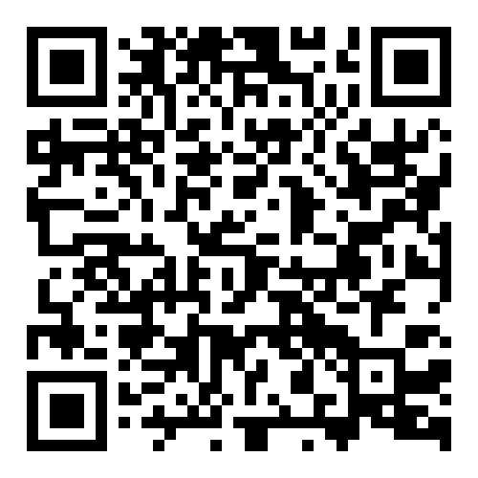
Task: What unites the people of Uusimaa?
Task
Uusimaa Day is celebrated every May in the municipalities of Uusimaa. We all belong to Uusimaa, everyone who is here now. On Uusimaa Day, we celebrate everything that connects us as residents: The nature and environment of Uusimaa, its unique contemporary culture and art, its diverse cultural heritage rooted around the globe, and our joint future.
Discuss with a partner or in small groups: What can a Uusimaa identity mean? What does it mean to us? Have you come across an Uusimaa meme? Have you seen a meme that could represent the Uusimaa spirit?
Read more about Uusimaa region
Notes:
OHJEET OPETTAJALLE Tehtävän kesto: noin 5 minuuttia, pidempään jos muun ajan puolesta mahdollista

Slide 5
Meme School principal Reeta Karjalainen talks about memes and mental health

Slide 6
Task: How are we doing?
Task
One third of all Finns lives in Uusimaa — around 1.8 million people.
Each of us contributes to the Uusimaa identity with who we are, where we come from, and what we are interested in. Uusimaa and its culture are not pre-defined or fixed elsewhere — it's up to us, the residents of today, to shape and evolve them. Let’s work together to make Uusimaa an even better place to live — both offline and online.
Take a moment with a partner or small group to talk about your feelings.
How are you feeling today?
Does a meme come to mind that captures the mood of today?
Notes:
OHJEET OPETTAJALLE Tehtävän kesto: noin 5 minuuttia, pidempään jos muun ajan puolesta mahdollista

Slide 7
Meme School Principal Jenna Jauhiainen talks about the power and responsibility of memes

Slide 8
Meme School final project: What unites us? Uusimaa Remix
Work alone, with a partner, or in a small group to create Uusimaa-themed memes. These can be image memes or short videos.
Instructions:
Use materials like the regional symbols of Uusimaa — such as the zander (fish), wood anemone (flower), blackbird (bird) — or content related to your home municipality, surroundings, or the region in general. You can also combine typical meme formats and other familiar meme content with Uusimaa themes.
Use your preferred image editing software.
Present your completed memes in small groups or to the whole class, time permitting.
PS: Share your meme
on social media with
the hashtags:
#uusimaaday
#uusimaapäivä #nylandsdagen
Notes:
OHJEET OPETTAJALLE Tehtävän kesto: noin 5 minuuttia, pidempään jos muun ajan puolesta mahdollista

Slide 9
Congratulations, graduates! You are now a Meme School Principal!

